Slide 1
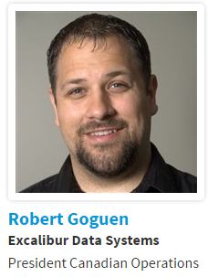
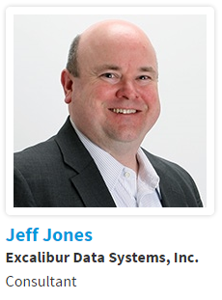
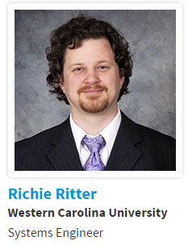
Building Powerful Workflow Automation with Cherwell and PowerShell

Slide 2
Agenda
Welcome & Session Introduction
What is PowerShell?
  PowerShell ISE
  Commands/Cmd-Lets
  Operators
  Variables
  Flow Control
LAB 1 – Exploring PowerShell
PowerShell Scripting
  Installing the Latest Version
  Execution Policies
  Script Files
  Parameters
  Output
  Modules

Slide 3
Agenda
LAB 2 – PowerShell Scripts
Using Scripting in Cherwell
  Using a One-Step
  Calling the script
    Setting the Parameters
    Getting the Output
    Handling Errors
  Stored Script or On The Fly
LAB 3 – Calling PowerShell Scripts from Cherwell One-Steps
Cherwell Orchestration Packs
  Active Directory
  Exchange
  VMWare vRealize
Q & A

Slide 4


Building Powerful Workflow Automation with Cherwell and PowerShell
  Your Mission…..
  Increase Value to the Business
  Reduce Cost
  Minimize Risk
  Improve Service Offerings
  No impact on Quality or Services
Notes:
Session Description:
IT departments are always looking for ways to automate and reduce the time it takes to perform day-to-day operational tasks such as creating user accounts, adding mailboxes and distribution lists, etc.. Each year countless hours are spent on this non-value added work, but does it have to be this way? What if Cherwell Service Management could give you back those hours, reduce human errors, and improve your MTTR? This pre-conference session will provide a basic introduction on how you can use the powerful Cherwell Service Management workflow automation, in combination with Windows PowerShell, to give you limitless time savings potential in your day-to-day operations. If you can do it in PowerShell, Cherwell Service Management can automate it.
-------------------
Speaker Notes:
All organizations today are faced with the ever increasing challenge of how to best utilize resources in the most effective way possible, and this is especially the case within the area of Business Technology / IT. IT Groups worldwide are constantly juggling between increasing value to the business at the same time reducing cost, minimizing risk, improve service offerings, all without impacting the quality of the services delivered to customers.
Within this session our goal is to help you remove a few balls you need to juggle by demonstrating how Cherwell can reduce and in some cases eliminate large portions of non-value added IT tasks using Windows PowerShell. Please keep in mind this sessions primary focus will be on using Cherwell to execute PowerShell and help automate processes. Due to time limitations our session will not dive into how to script in PowerShell, however at the end of the presentation we will have resources available to everyone that will help you get started if you are unfamiliar with PowerShell or want to learn more.

Slide 5

What is PowerShell?
  What is PowerShell?
  PowerShell is an automation platform and scripting language for Windows and Windows Server that allows you to simplify the management of your systems. Unlike other text-based shells, PowerShell harnesses the power of the .NET Framework, providing rich objects and a massive set of built-in functionality for taking control of your Windows environments (Source: MSDN)
  Why PowerShell?
  Most Microsoft Systems are managed using PowerShell. It is Microsoft’s go-forward technology that will be used to manage all products in the future.
Notes:
What is PowerShell?
PowerShell is an automation platform and scripting language for Windows and Windows Server that allows you to simplify the management of your systems. Unlike other text-based shells, PowerShell harnesses the power of the .NET Framework, providing rich objects and a massive set of built-in functionality for taking control of your Windows environments. (Source MSDN)
Microsoft’s intent with PowerShell was to provide a replacement for the existing command line that exist in windows today, that provides a configuration management framework with an associated object based scripting language built upon the .NET Framework.
Why PowerShell?
This is Microsoft’s preferred configuration platform going forward. Most MS products that exist today such as Microsoft Exchange, System Center Configuration Manager (SCCM), Microsoft SharePoint, Microsoft SQL, Windows Server, Windows 7 and up, O365 etc. All use PowerShell as a configuration platform. In fact, the administration tools for the front end of these systems are simply GUI’s sitting on top of PowerShell such as the Exchange Management Console (EMC) / Exchange Admin Center (EAC).

Slide 6
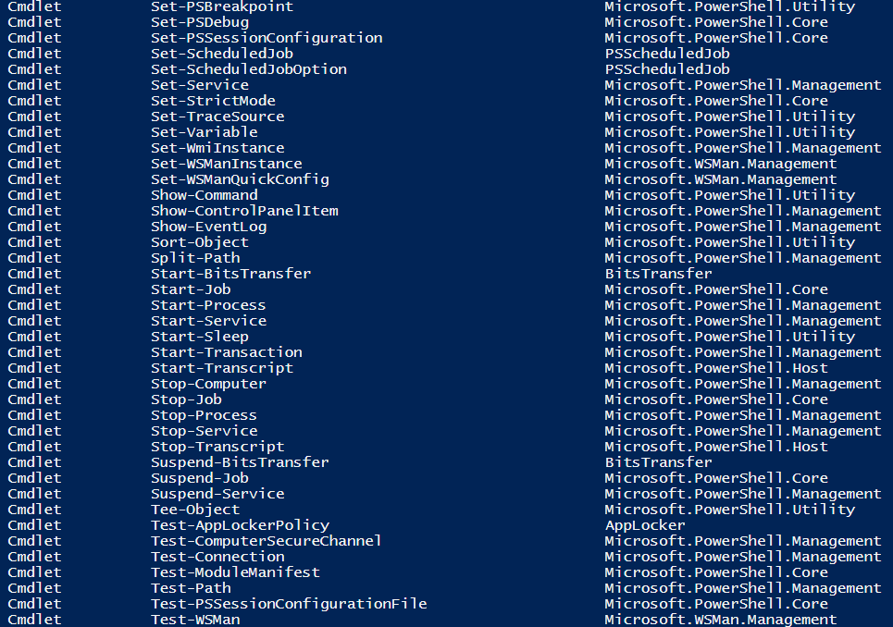
What is PowerShell?
  What can I do with PowerShell?
  Just About
  Anything!
100’s of Cmdlet’s, Functions and
1000’s of Parameters
Notes:
What can you do with PowerShell?
Just About Anything!
PowerShell has 100’s of cmdlet’s, functions and 1000’s of parameters that you can use to configure and manage your environment. Microsoft is continuing to make more and more server functions command-line-only, settings and parameters that are only accessible using PowerShell.

Slide 7
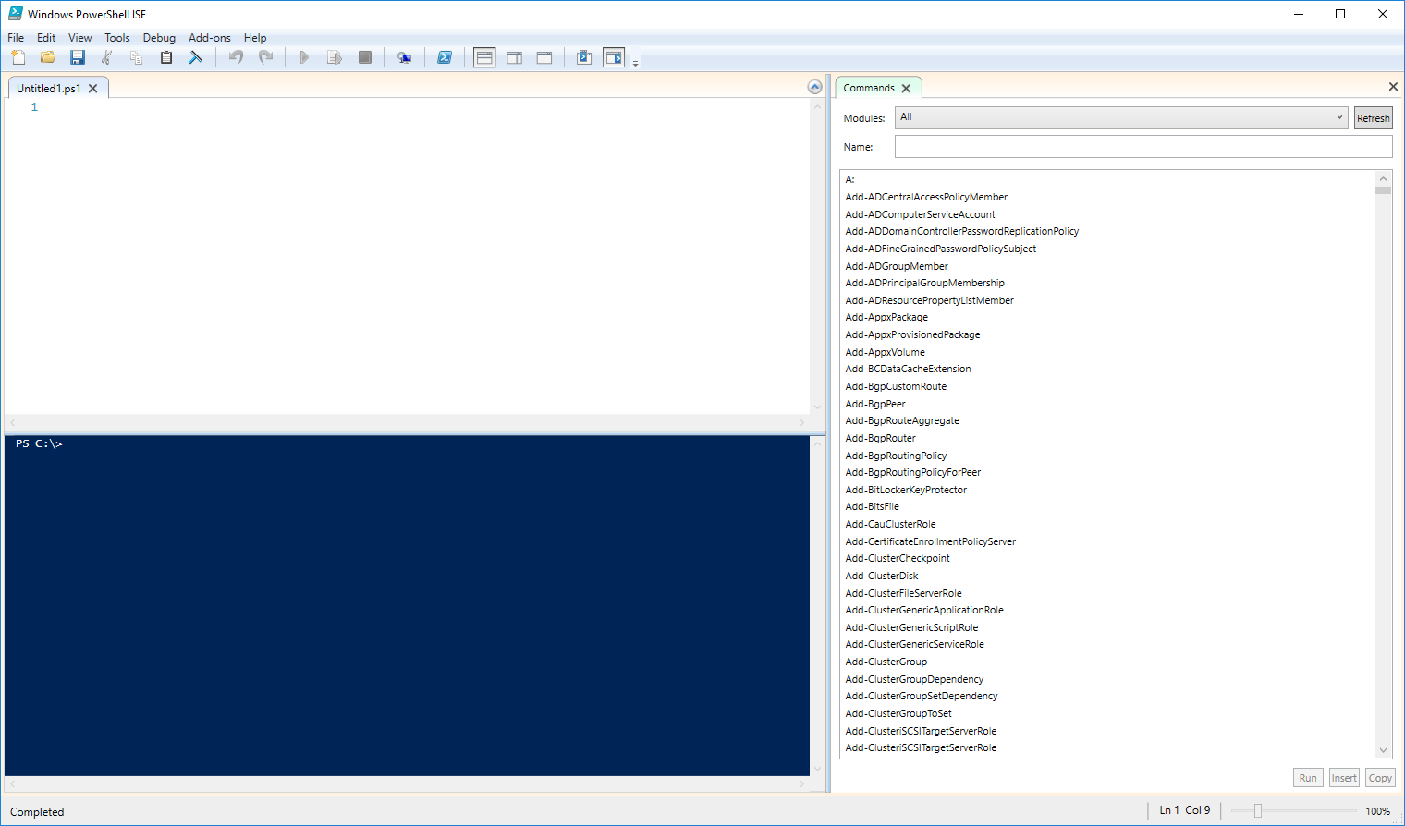
PowerShell ISE

Slide 8
Commands/Cmd-Lets
Cmdlets are the bones of PowerShell.
Follow a naming pattern of Verb-Noun where most verbs are standardized and most nouns have multiple verbs.
Some Examples:
  Get-Help
  Get-Date, Set-Date
  Get-Service, New-Service, Start-Service, Stop-Service, Restart-Service
  To see cmdlets for a given verb you can use PS C:\> Get-Command -Noun verb
    i.e. - PS C:\> Get-Command -Noun service
Notes:
Note that the Noun part of the Cmdlet should be singular.
Nouns with multiple verbs are called Cmdlet Sets
Get-Date probably disappoints people.
Microsoft says: “the term New is a valid Windows PowerShell verb name because it implies an action even though it is not a verb in the English language”

Slide 9
Commands/Cmd-Lets
Important or useful cmdlets
  Get Help
    PS C:\> Get-Help Some-Cmdlet -Show help for Some-Cmdlet
    PS C:\> Get-Help Some-Cmdlet -full -Show detailed help
    PS C:\> Get-Help Some-Cmdlet -online -Open the web page for the cmdlet
    PS C:\> Get-Help Some-Cmdlet -examples -Show cmdlet usage examples
    PS C:\> Get-Help *findsomething* -Search the help system for commands

Slide 10
Comparison Operators
-eq Equal
-ne Not equal
-ge Greater than or equal
-gt Greater than
-lt Less than
-le Less than or equal
-like Wildcard comparison
-notlike Wildcard comparison
-match Regular expression comparison
-notmatch Regular expression comparison
-replace Replace operator
-contains Containment operator
-notcontains Containment operator
-shl Shift bits left (PowerShell 3.0)
-shr Shift bits right – preserves sign for signed values.(PowerShell 3.0)
-in Like –contains, but with the operands reversed.(PowerShell 3.0)
-notin Like –notcontains, but with the operands reversed.(PowerShell 3.0)

Slide 11
Comparison Operators (example)
PS C:\> "abc" -ne "def"
True
PS C:\> 8 -gt 6
True
PS C:\> "Windows PowerShell" -like "*shell"
True
PS C:\> "abc", "def" -Contains "def"
True
PS C:\> "Get-Process" -Replace "Get", "Stop“
Stop-Process
PS C:\> "book" -Replace "B", "C“
Cook
PS C:\> 2 -eq 3
False
PS C:\> "ghi" -NotIn "abc", "def“
True

Slide 12
Variables
Variables are used to store dynamic or changing data in your PowerShell script.
A variable can hold a simple number:
  PS C:\>$mynumber = 42
Or a string:
  PS C:\>$mystring = ‘The Quick Brown Fox’
Or an array:
  PS C:\>$myfolder = dir
Or any other data
Once a variable is set it can then be used anywhere a data element is used in PowerShell
In comparisons
  PS C:\> $mynumber –eq 12
In arithmetic
  PS C:\> $mynumber + 10
In assignments
  PS C:\> $mynewstring = $mystring + ‘ jumped over the lazy dog’
In Cmdlet/Function calls
  PS C:\> $myfolder | Write-Output

Slide 13
Flow Control
Branching
  If/Then/Else/ElseIf
Looping
  While
  Do While/Do Until
  For
Iterating
  ForEach
  ForEach-Object
Skipping, Escaping and Exiting
  Continue
  Break
  Exit
  Examples
  If ( $true –eq $false) { do something } else { do something else }
  For ( $counter = 1; $counter –le 10; $counter++ ) { do something}
  $counter = 0; do { $counter++; do some work } until { $counter –eq 10 }
  Dir | ForEach-Object { do something }
  $files = dir
  $searchfor = ‘myfilename’
  ForEach ($file in $files)
  { if ($file –eq $searchfor) { write-output ‘found it’; break } }

Slide 14
LAB 1 – Exploring PowerShell

Slide 15
PowerShell Scripting
  Installing the Latest Version of PowerShell (5.x)
    PowerShell is 5.0 is installed by default on Windows 10 and 5.1 is scheduled to be released with Windows Server 2016
    5.0 is installed as part of Windows Management Framework 5.0
    5.0 can be installed on
      Windows Server 2008 R2 SP1, 2012, and 2012 R2
      Windows 7 SP1, 8.1
    Requires Microsoft .NET Framework 4.5 or above
Notes:
Windows Server 2016 should be out by the time we present, so may need to update this slide.

Slide 16
PowerShell Scripting
Execution Polices
  Determine what PowerShell scripts are allowed to run on your computer
  Options: Restricted (default), AllSigned, RemoteSigned, Unrestricted
  View current policy: PS C:\> Get-ExecutionPolicy
  Set policy: PS C:\> Set-ExecutionPolicy RemoteSigned
  Note: Execution polices are not meant as a security control. They are supposed to help prevent administrators and users from making unintended mistakes. We can easily bypass them by changing the policy locally or as we call a script.
Notes:
Restricted – Interactive use only. No scripts. (default on all windows versions except for Server 2012 R2)
AllSigned – Only allow scripts that have been signed by a trusted publisher
RemoteSigned – Locally run scripts do not need to be signed (default on Server 2012 R2)
Unrestricted – All scripts can be run
For instance https://blog.netspi.com/15-ways-to-bypass-the-powershell-execution-policy/
15 ways to bypass PowerShell execution polices without being an administrator

Slide 17
PowerShell Scripting
Script Files
  PowerShell scripts are a flexible and powerful way to perform management and automation tasks
  Scripts generally have a *.ps1 extension and can be created easily or downloaded from places like the Microsoft Script Center.
  Bad scripts
    Be careful as scripts could possibility damage your systems either maliciously or just through coding mistakes.
    Use trusted sources
    Run in test first
    Learn PowerShell syntax so you can “read” a script before running it.
Notes:
Script examples:
calling a single cmdlet
using modules to automate account creation in AD
Assigning licenses in O365
creating virtual servers in VMWare vSphere
What resources should we give for script repositories?

Slide 18
Parameters
Parameters are used to pass data into functions and scripts.
For example, if you had a function named SetUserPassword, you might want to pass in the user name and the new password as parameters to tell the function what to operate on.
    Function SetUserPassword {
      Param ( [string]$username, [string]$password )
      // do something to set the password
    }
Parameters can be made mandatory, positional or attached to the pipeline using the optional [Parameter()] attribute:
  Param( [Parameter(Mandatory=$true, Position=1, ValueFromPipeLine=$true)][string]$username)

Slide 19
Output
Often you will need to output data, status and error messages in some format consumable by the user, either visible on the display or in an output file.
PS C:\>Write-Output $somevariable - outputs the value of the variable on the display or output stream
PS C:\>Write-Host $somevariable – outputs the value of the value on the display only
PS C:\>$somevariable | Out-File $filename – outputs the data piped in to the specified file. Out-File has number of useful parameters you can use such as Append, NoClobber and Force, be sure to check out the online help for these.
PS C:\>dir | Export-CSV $filename – outputs the data piped in to a CSV formatted file.

Slide 20
Modules
Modules are used to extend the functionality of PowerShell and group related functions and code together into a easily re-usable package. You can create your own modules, or use the many pre-existing modules that add extended functionality to PowerShell to do things like automated backups, interact with Active Directory or control your VMWare infrastructure.
PS C:\>Get-Module
  Returns a list of currently loaded modules
PS C:\>Get-Module –ListAvailable
  Returns a listing of all modules found on the system
PS C:\>Import-Module ModuleName
  Loads a module previously installed on the system

Slide 21
LAB 2 – PowerShell Scripts

Slide 22
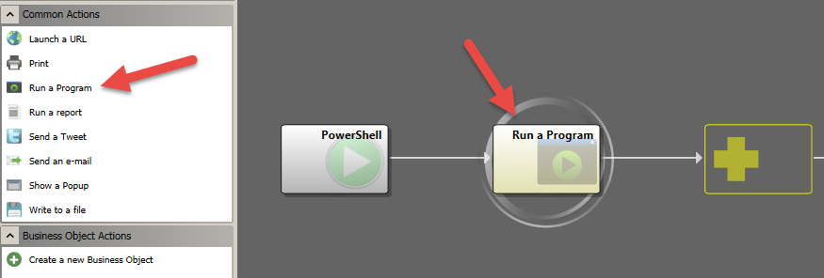
Calling a Script

Slide 23
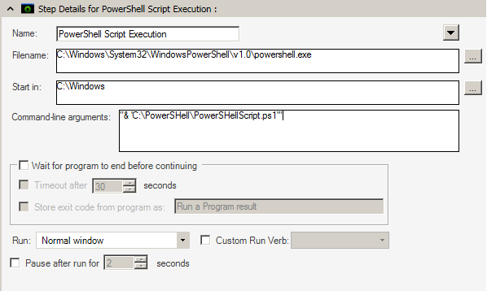
Calling a Script
Display Name of Action
Location of PowerShell Executable
Execution of Script with parameters
Define how One-Step Interacts with Script Execution
Notes:
Defining the script execution:
Name: This is the display name used within the One-Step
FileName: The location of PowerShell. The default is: (:\Windows\System32\WindowsPowerShell\v1.0\powershell.exe
Command-Line Arguments: This is where you call out the script you are executing along with any additional arguments you would like to pass into the script. You can pass values into the script for consumption.
One-Step Interaction Definition: This area is where you can define how the One-Step itself can interact with the execution of the script.
Wait for Program to End before Continuing: Select this check box to have the One-Step wait until the program finishes executing before continuing to the next Action.
Note: The next two options are only available if you select Wait for Program to End before Continuing.
Timeout after X Seconds: Select this check box to have the One-Step either wait until the program is finished executing or the specified number of seconds has passed.
Store Exit Code from Program: Select this check box to have CSM store the program’s return code for use in future One-Step Actions. Then, provide a name for the variable that will hold the return code. It is then available as a variable in the system.
Note: This is not required; however, in most cases, you want to store the program result so that you can do something with it (ex: Create a Journal that records the result).
Define how the program should run:
Run: In the drop-down, select the type of window to run the program in.
Normal Window: Select this option to have the program run in a normal size window
Minimized: Select this option to have the program run in a minimized window (shown in taskbar).
Maximized: Select this option to have the program run in a maximized window (fills entire computer screen).
With No Window: Select this option to have the program run without being shown in a window.
Custom Run Verb: Provide an additional parameter that tells the program how to run (if the program requires one). Note: Some common verbs are NEW, OPEN, EDIT, and PRINT. Consult your program’s documentation to find out what verbs are available. If the program makes its list of supported verbs available, they are displayed in the drop-down.
Pause after Run: Select this check box to have the One-Step pause for a few extra seconds after running the program before continuing to the next Action. Then, specify the number of seconds the One-Step should pause.

Slide 24
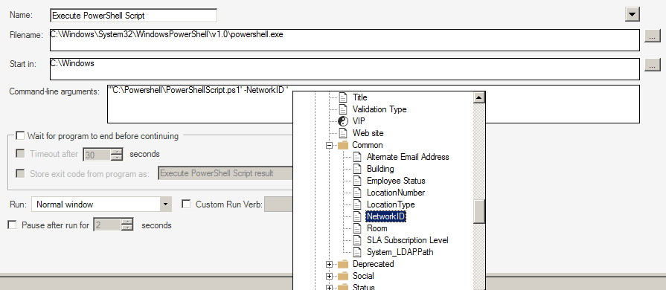
Calling a Script – Setting Parameters
“& ‘Script Location’ –Parameter1 Value”
Notes:
You can pass named variables into the PowerShell script via the command line argument.

Slide 25
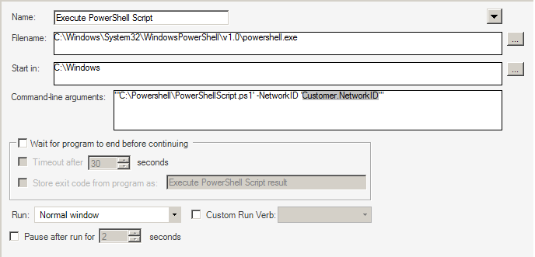
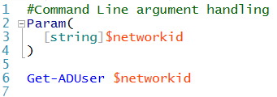
Calling a Script – Setting Parameters
Notes:
You can pass named variables into the PowerShell script via the command line argument. You can pass as many variables into the script as want, and have the script use this information. Particularly useful for setting up a new user account, mailbox or distribution group in Active Directory.

Slide 26
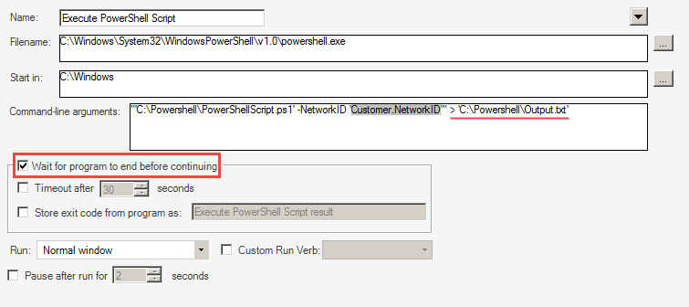
Calling a Script – Output
> “<location>\Filename.txt”
Notes:
If your script has output that you need, you can import the output from your script back into Cherwell. To do this you first need to add to your command line argument by directing any output your script has into a file. It is very important when working with Output files you will want to check “Wait for program to end before continuing”. This will ensure that other steps within your one-step wait for the script to complete before executing. This is particularly important when your script has an output you need to import back into Cherwell, as you will want the script to complete before attempting to import the data.

Slide 27
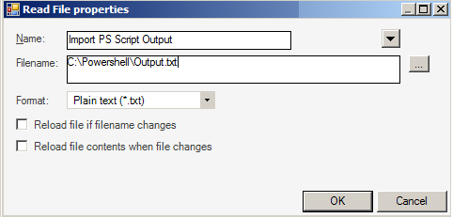
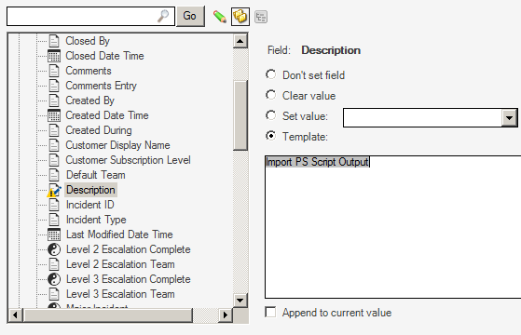
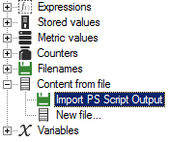
Calling a Script – Output
Notes:
Read contents from the output file back into the business object by selecting “Content form file”. Point this to the output file and it will read the contents of the file back into Cherwell. Visibility is key, so any output files produced will need to be accessible.

Slide 28
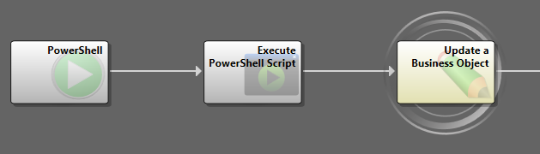
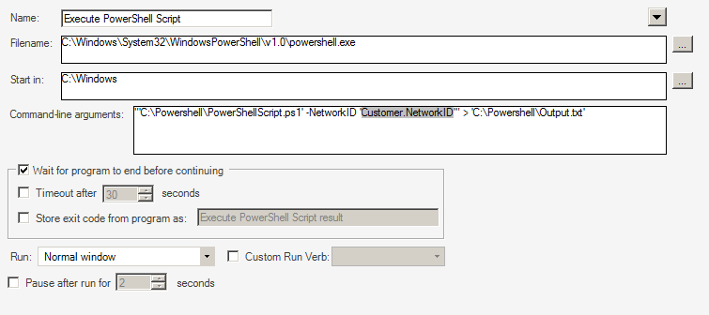
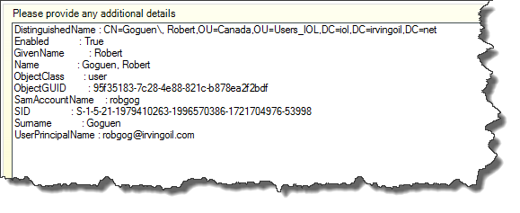
Calling a Script – Output
Notes:
Once the One-Step is executed, the PowerShell script will run and output its results into a file. The next step in the One-Step will import the information from the file and update a field within the ticket. In this example, the results of running the Get-ADUser cmdlet are stored in the description field on the incident ticket.

Slide 29
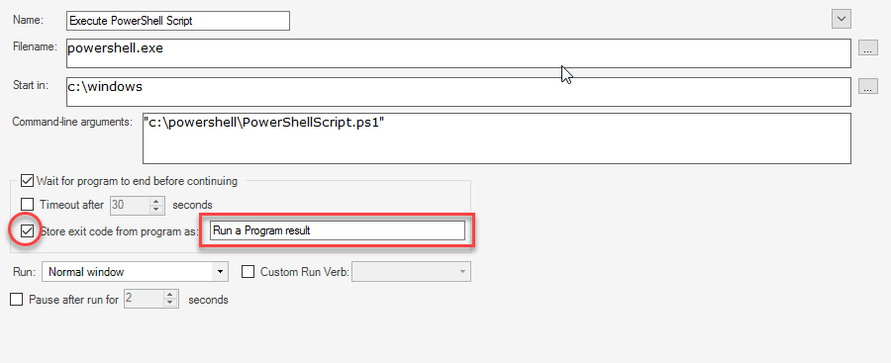
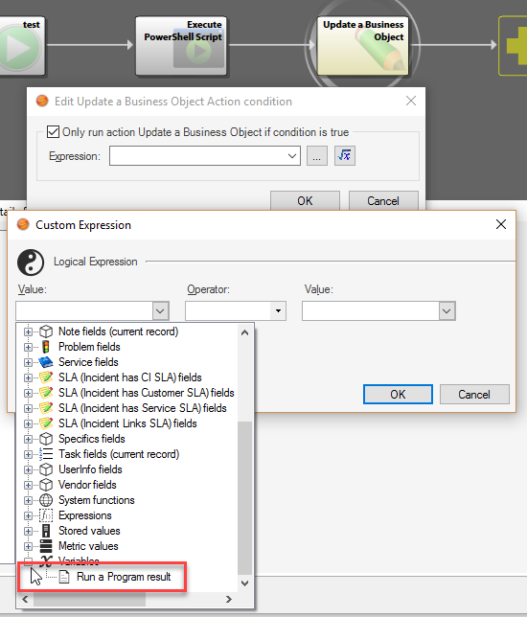
Handling Errors

Slide 30
Using Scripting in Cherwell
Stored Script or On The Fly?
From Cherwell we have two methods for accessing a script.
The first method is by calling an existing script stored on the computer’s hard drive or on a network share. This requires that the user have access to the file when the script is called otherwise the execution will fail. For complicated scripts, scripts that may change frequently or scripts that need to be secured from prying eyes this may be valid method, but for the most part you’ll likely want the other method.
The other method is to build the script on the fly and store it to a temporary file in your One-Steps using the Write To A File action, then call that file you created from a Run Program action, after the script completes it can be automatically deleted via the One-Step’s Write To A File setup.

Slide 31
LAB 3 – Calling PowerShell Scripts from Cherwell One-Steps

Slide 32
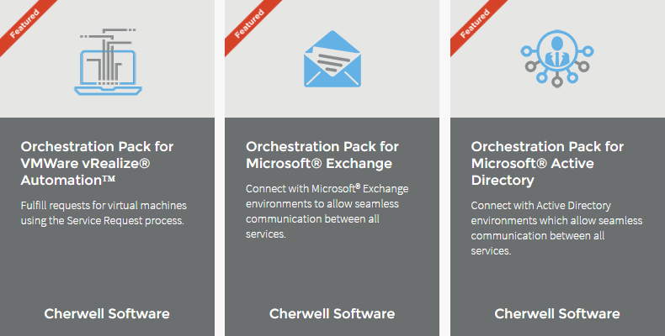
Cherwell Orchestration Packs

